Slide 1


Image & Video Processing, Analysis of Traffic Signal Areas to Find Emergency Vehicles Using Deep Learning Models
Mid-Review 1
Major Project
Project ID: A11
AY 2021-25
GITAM (Deemed-to-be) University
Project Team:
BU21EECE0100515 P Lakshmi Vignesh
BU21EECE0100487 Lalam Jithendhra
BU21EECE0100104 Moda SriRangaManjula
Department of Electrical Electronics and Communication Engineering
Project Mentor:
Sanhita Manna
PROJECT CORDINATOR:
Dr Ambar Bajpai
www.gitam.edu

Slide 2
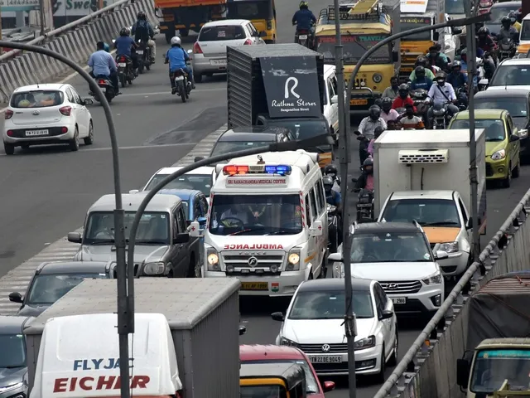
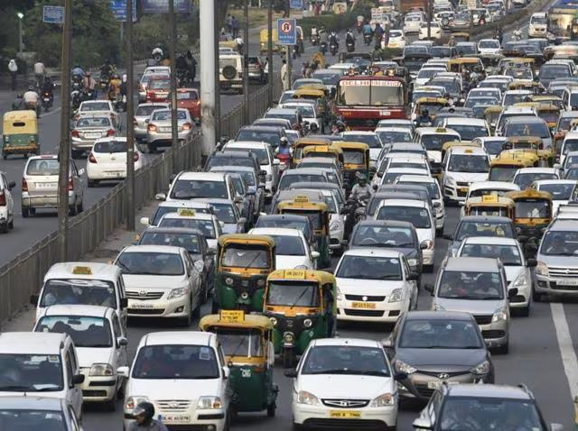
INTRODUCTION:
This problem statement revolves around the need to develop an advanced system that can automatically monitor, process, and analyze images and videos from traffic signal areas. By applying image and video processing, deep learning, and AI to analyze the vehicles to identify the high priority vehicles and to prioritize them at traffic junctions.

Slide 3
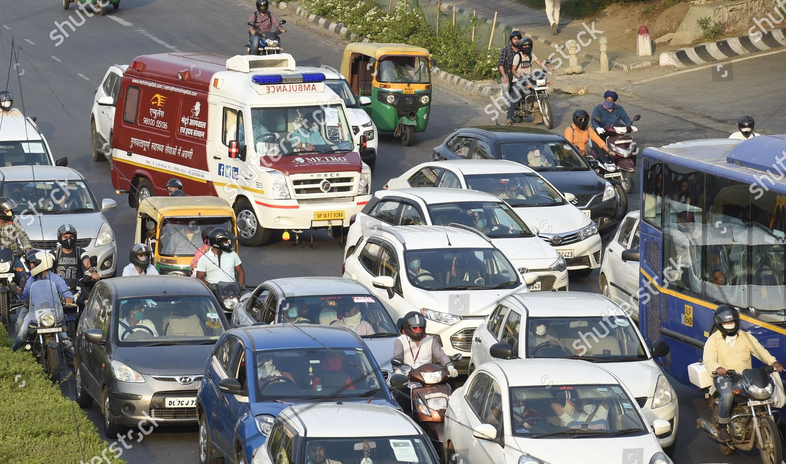
ABSTRACT:
In any part of our life, each of us has encountered high-priority vehicles like ambulances and fire engines waiting during their time of emergency while being stuck at traffic signal areas. We can save significant time and prioritize vehicles at traffic signals by analyzing and executing better algorithms with the help of video processing and Al models. The main motto of this project is to eliminate the excess time and prioritize the vehicles at the traffic signals. This can be achieved by training deep learning models.
The model will analyze the vehicles and identify high priority vehicles such as ambulances and fire engines. Finally, traffic signal control systems need to be integrated with the Al models analyze vehicles based on real-time traffic conditions and the presence of high-priority vehicles.

Slide 4
Objective and Goals
Objective
This project involves developing a machine learning model that utilizes object detection techniques to analyze vehicle density across traffic lanes. An algorithm will be designed to display identified high priority vehicles at traffic junctions, enabling reduced emergency rate and accurate predictions.
The objective of our project is to collect datasets best suited for segmentation, relabel and reannotate them with masked coordinates to support instance segmentation.
To train a new object detection model with added instance segmentation to improve the previous model.
Goals
Main Goals
To identify emergency vehicles and classify them as high-priority vehicles separate from the rest of the vehicles.
To identify the lane of emergency vehicles and communicate their presence to traffic signal junctions for prompt action.
Additional Goals
To reduce the emergencies for people by prioritizing the high priority vehicles.
To reduce the waiting time of high-priority vehicles at traffic junctions.

Slide 5
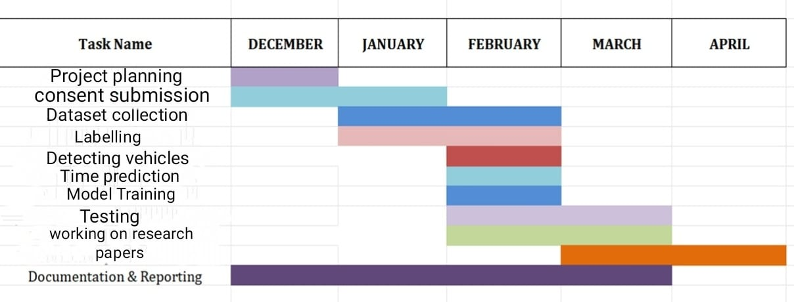
Project Plan (Clearly mention milestone for objectives under each reviews)
Gant Chart - Milestones and Activities
Resources : https://www.officetimeline.com/gantt-chart/how-to-make/excel & https://www.teamgantt.com/

Slide 6
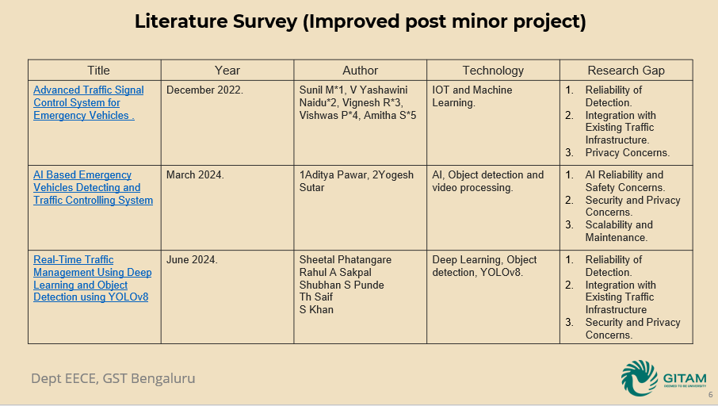

Slide 7
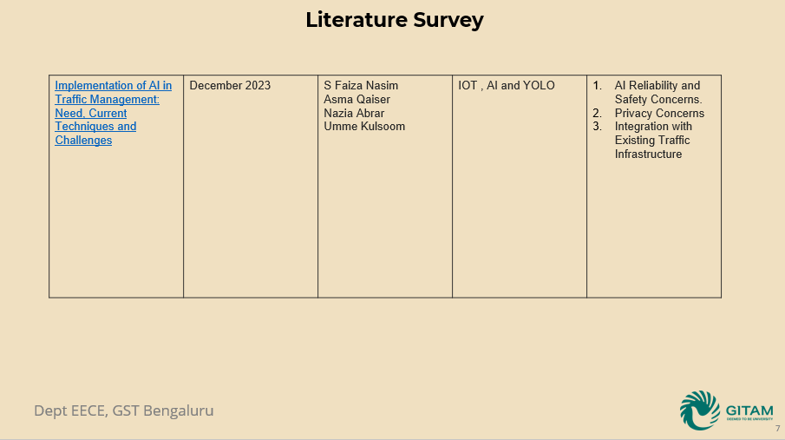

Slide 8




Structural Diagram
Block Diagram/Pin Diagram:
DATASETS
LABELLING AND ANNOTATING
SEGMENTATION , MASKING
PREPROCESSING OF IMAGES
DATA AUGMENTATION
MODEL TRAINING
INSTANCE SEGMENTATION
TESTING

Slide 9
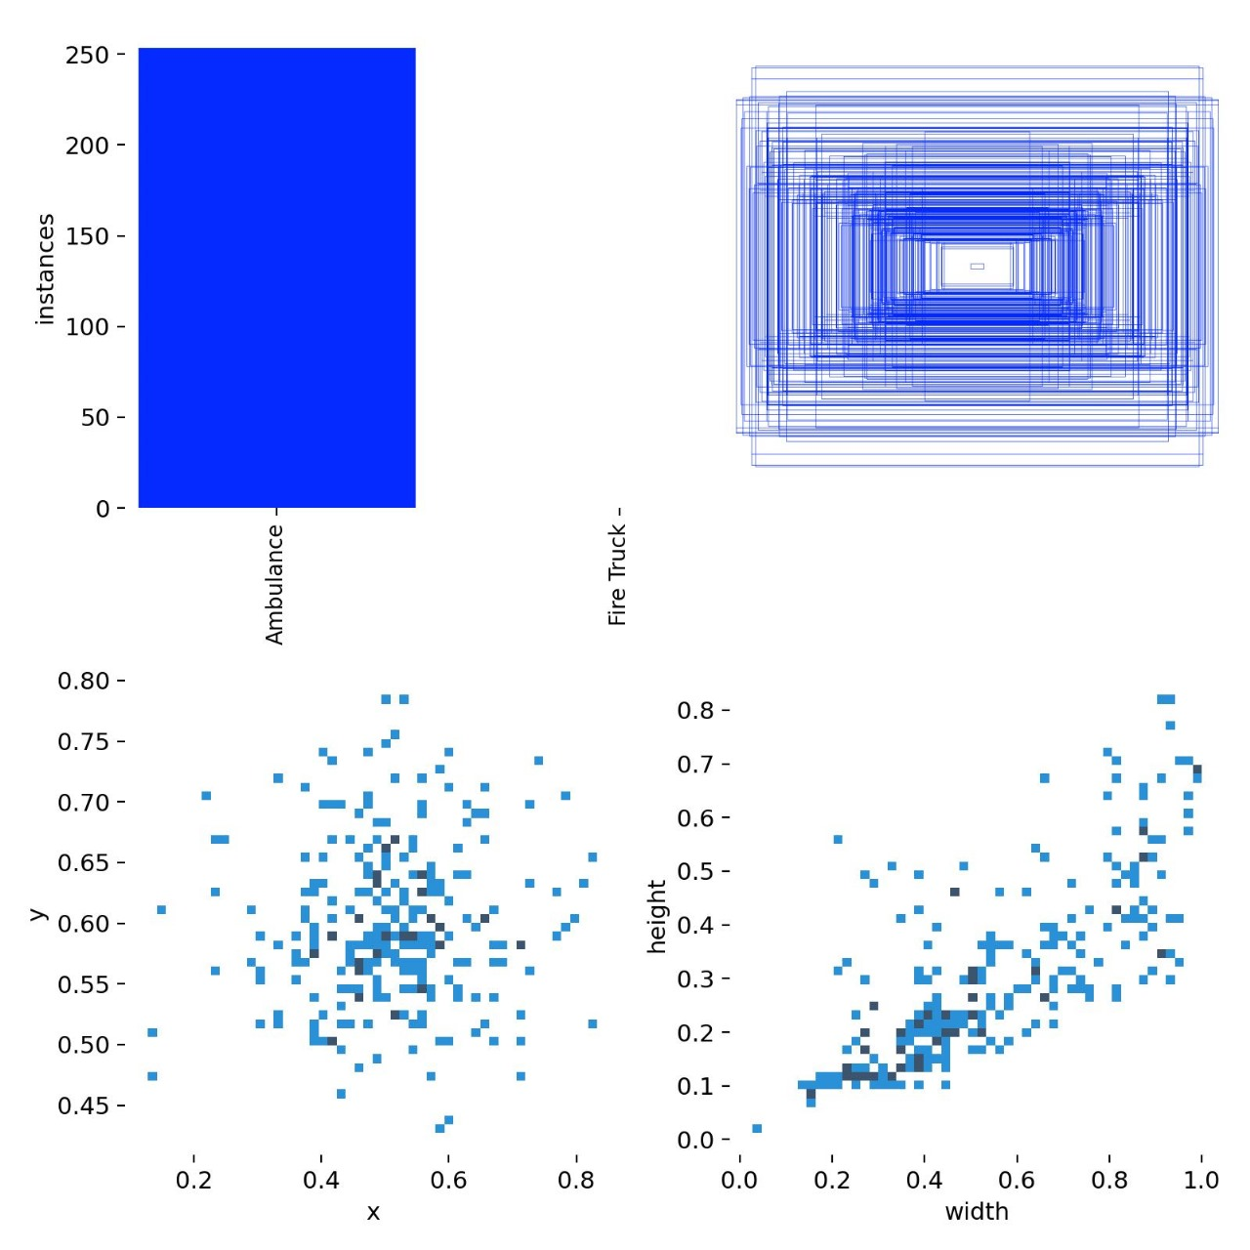
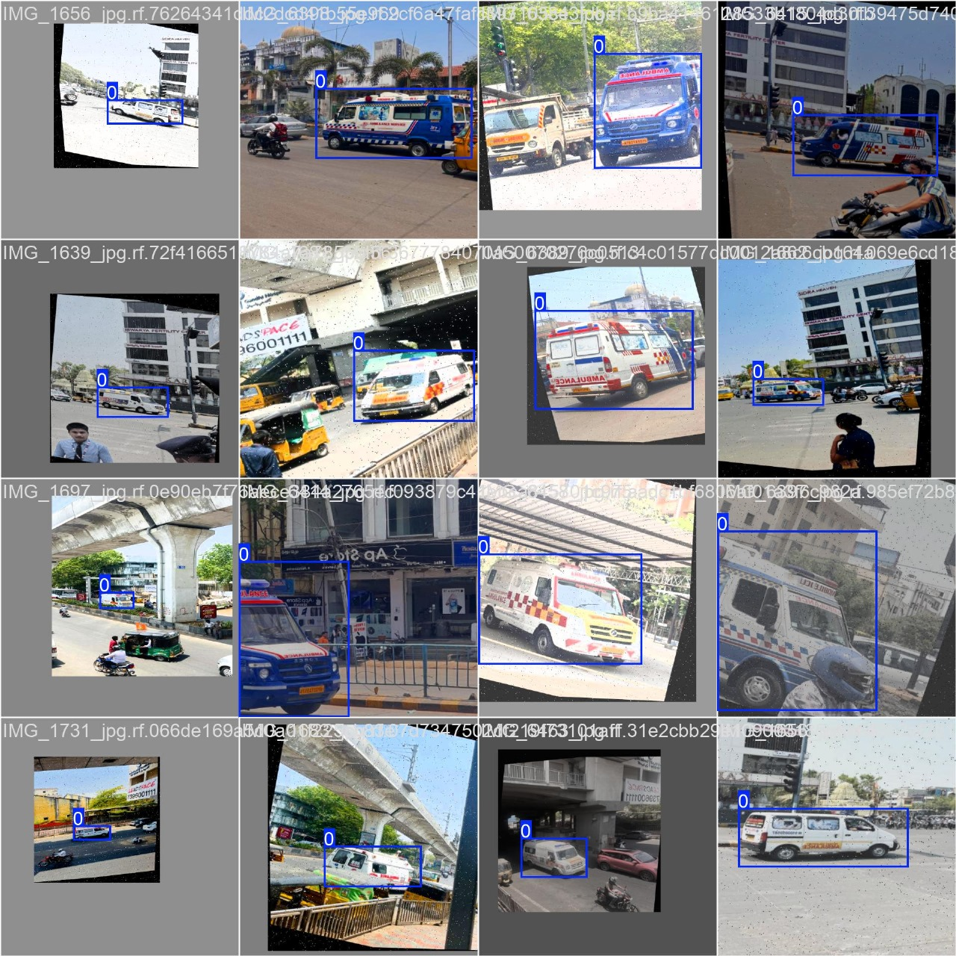
Implementation and Results
Iteration : Results + Validation against the use cases and test cases
Iteration 1:
The final YOLOv11n model, after 50 epochs, was able to accurately detect ambulances with high precision.
The model was able to achieve over 73% detection accuracy, making it moderate reliable for real-time traffic management.
Label mapping Annotation result

Slide 10
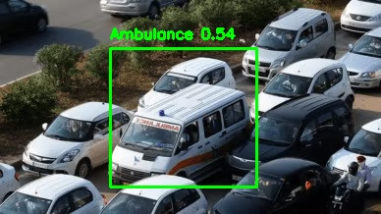
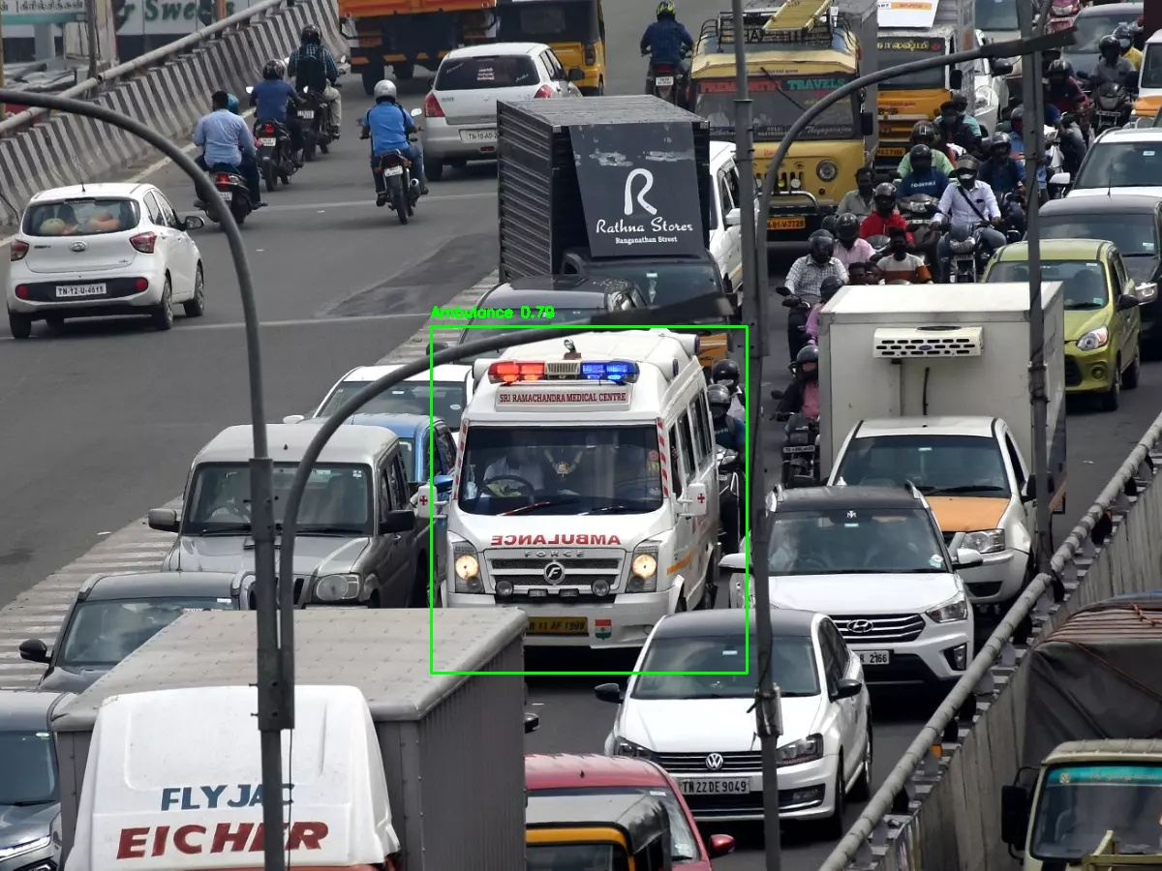
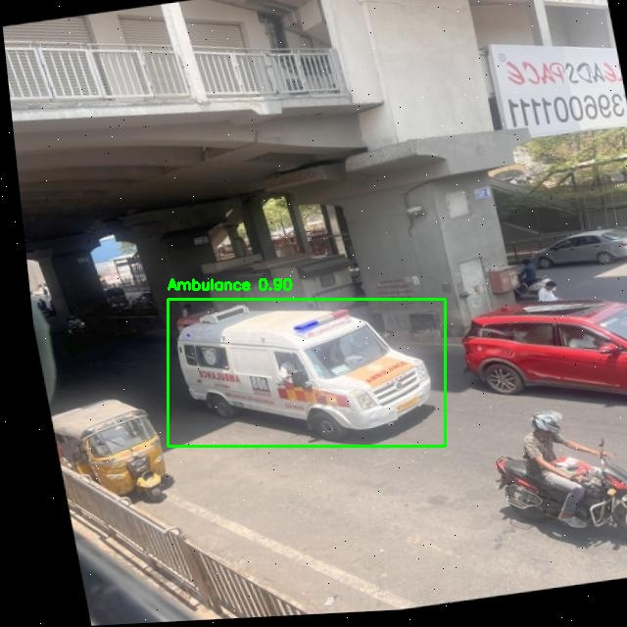
PREDICTIONS

Slide 11
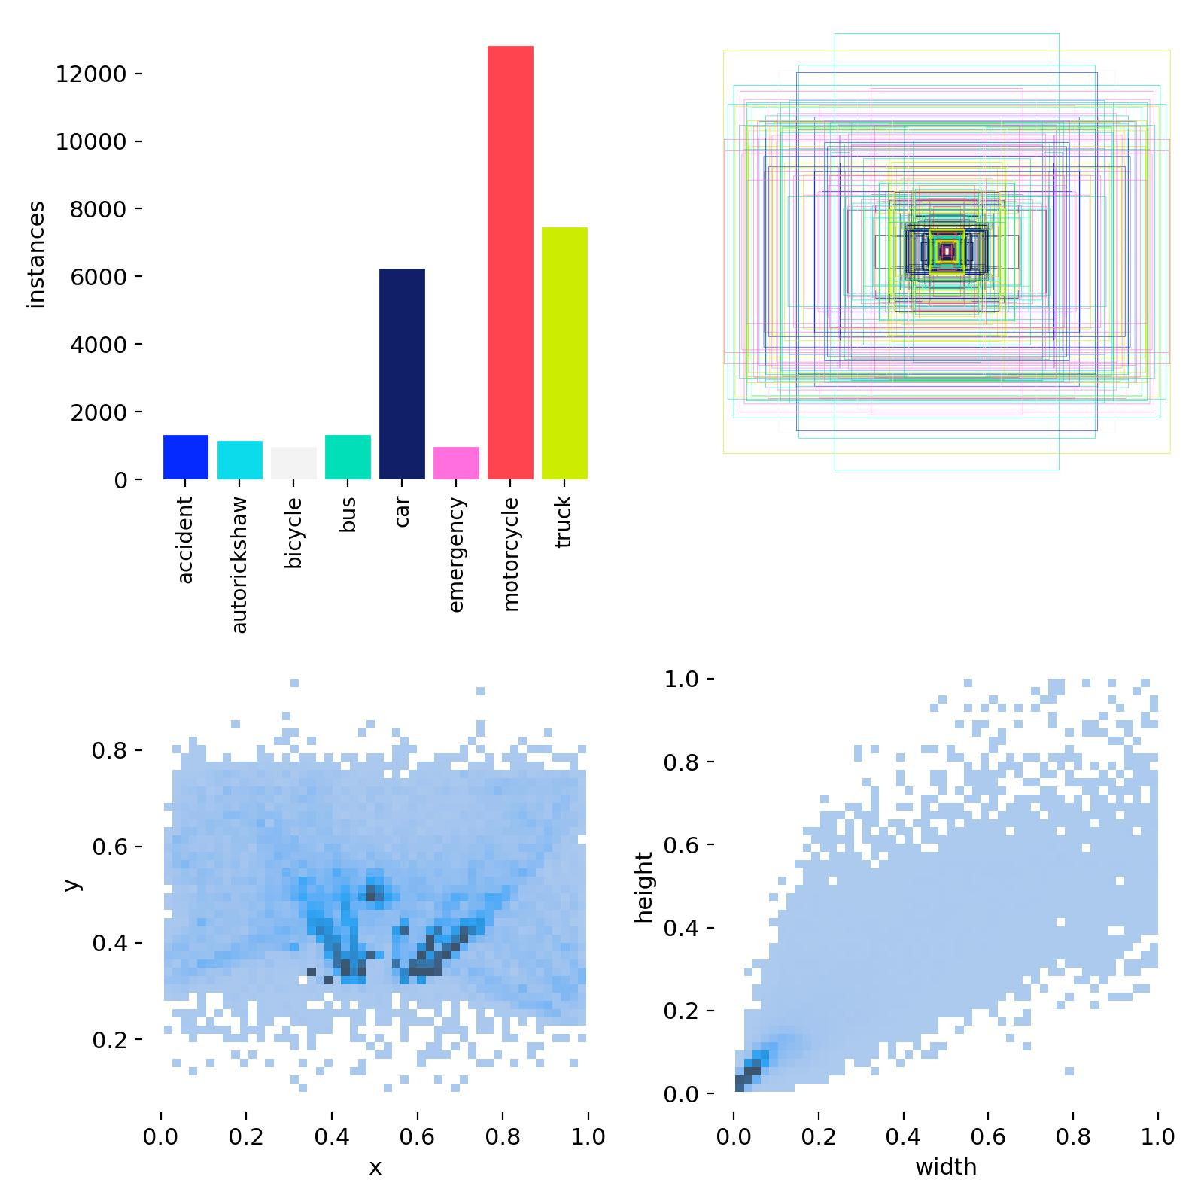
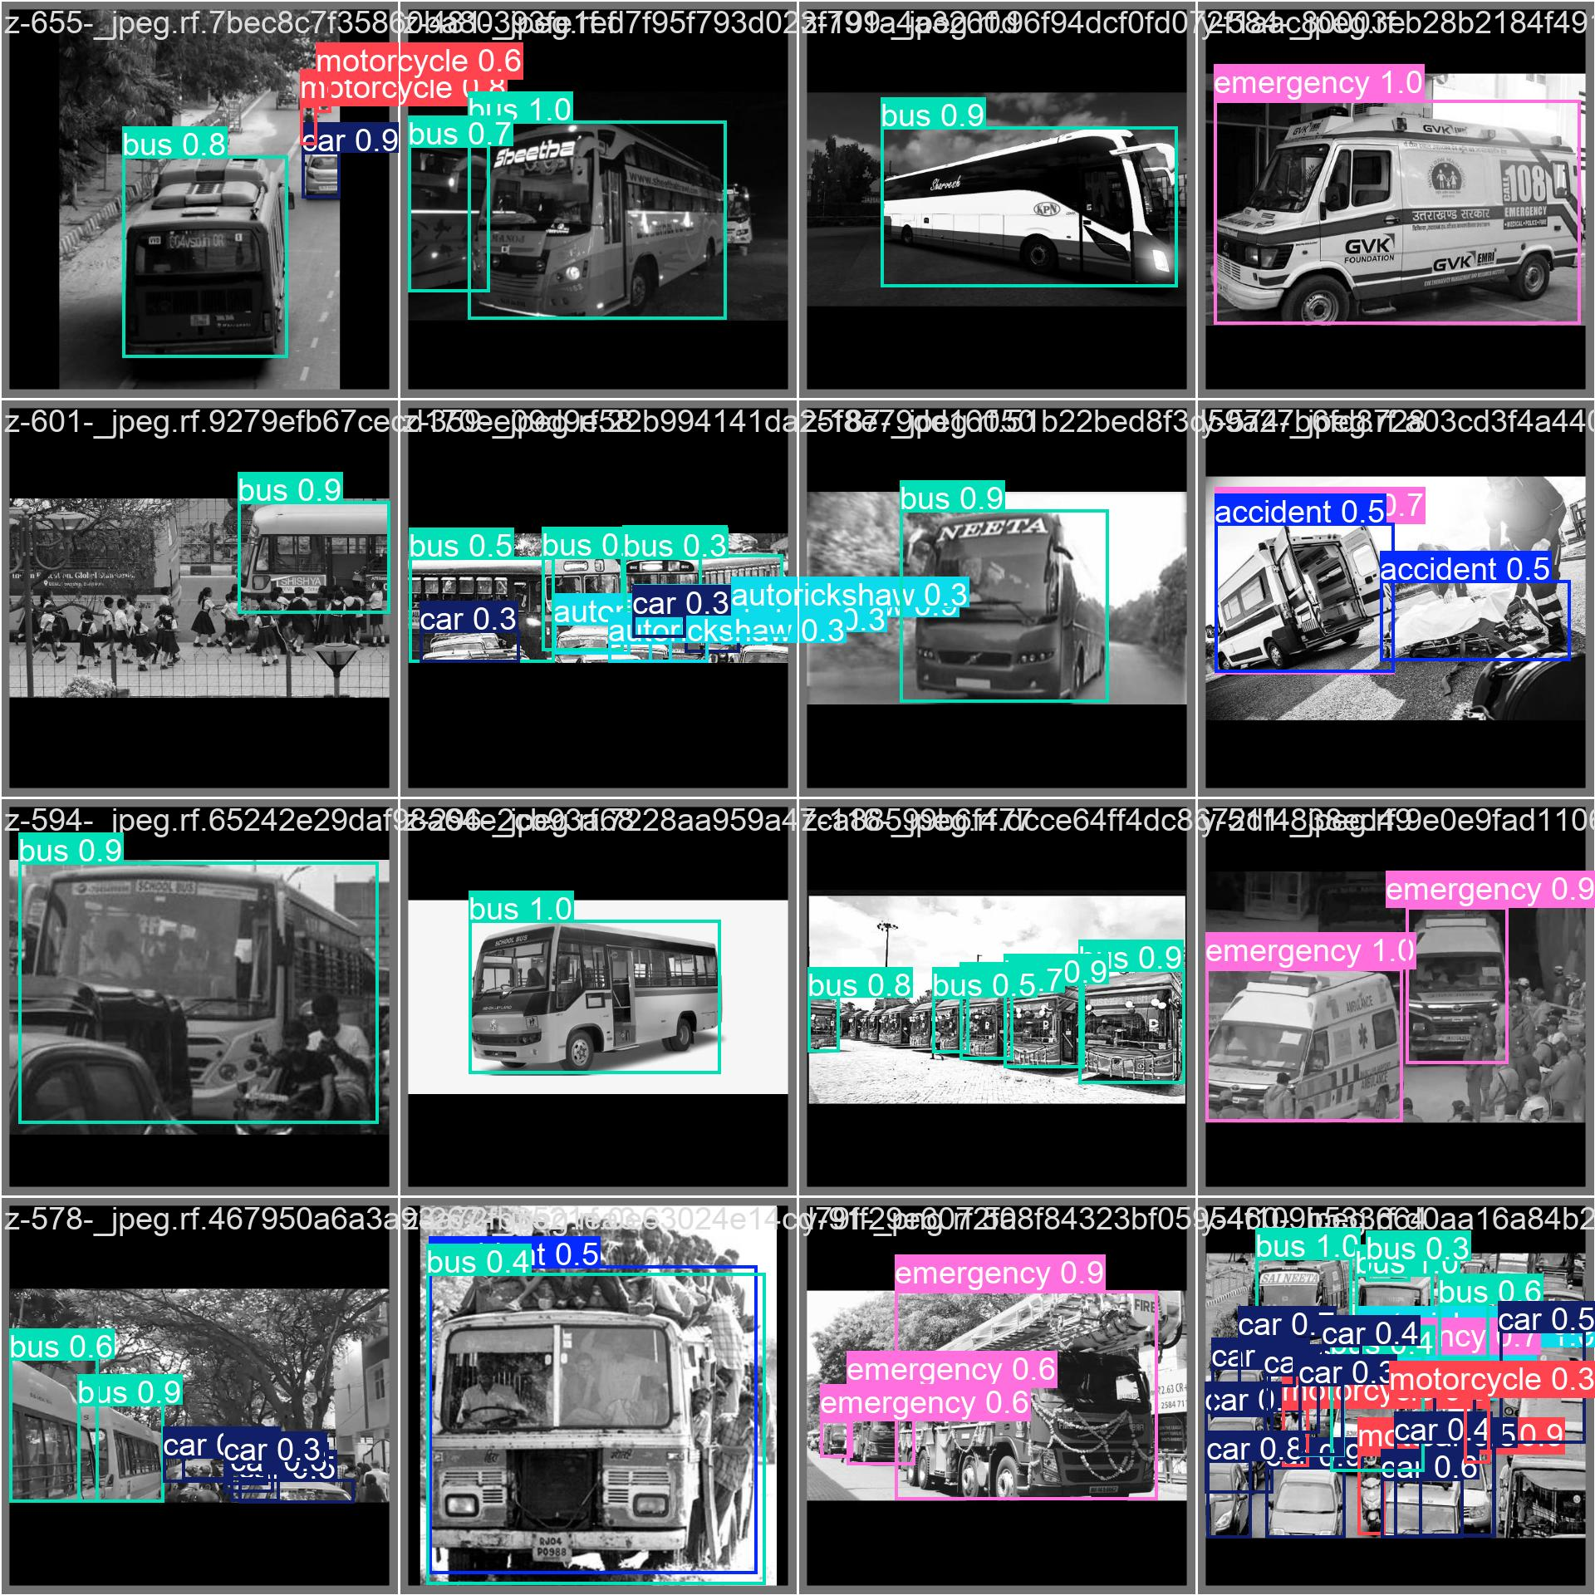
Implementation and Results
Iteration 2:
We have enhanced the accuracy of detecting high-priority vehicles (ambulances and fire engines) as well as other vehicles, such as bikes, cars, and motorcycles, while further improving the system's overall performance.
Additionally, we utilized instance segmentation to classify each vehicle type, including bikes, cars, ambulances, and fire engines, which significantly boosted detection accuracy.
Label mapping Annotation Results

Slide 12
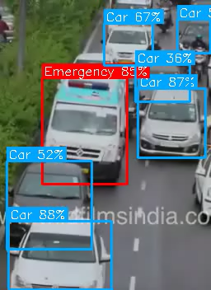
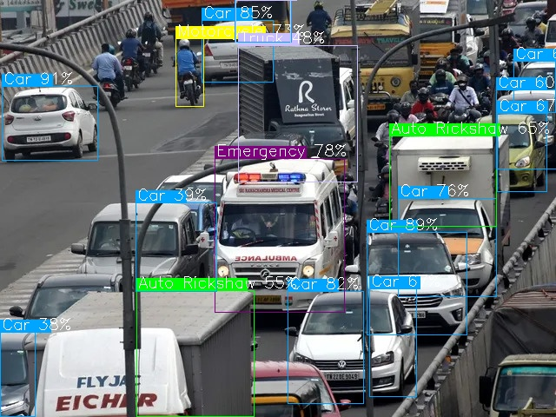
I2 - Results
Vehicle Segmentation

Slide 13
Implementation and Results
Final Testing Iteration and Results:
High-Accuracy Detection – The YOLOv11-seg.pt model achieved over 90% accuracy in detecting emergency vehicles after multiple iterations and data augmentation techniques.
Distance-Based Signal Control – The system successfully estimated the distance of emergency vehicles from traffic signals and dynamically assigned clearance time ensuring priority-based traffic management.
Multi-Vehicle Classification – Improved instance segmentation allowed the system to distinguish between emergency vehicles, cars, bikes, and auto-rickshaws with high confidence levels, enhancing overall traffic analysis.
Real-Time Performance – The final model processed live video feeds , detecting emergency vehicles and optimizing traffic signals efficiently, making it suitable for real-world deployment in smart traffic systems.

Slide 14
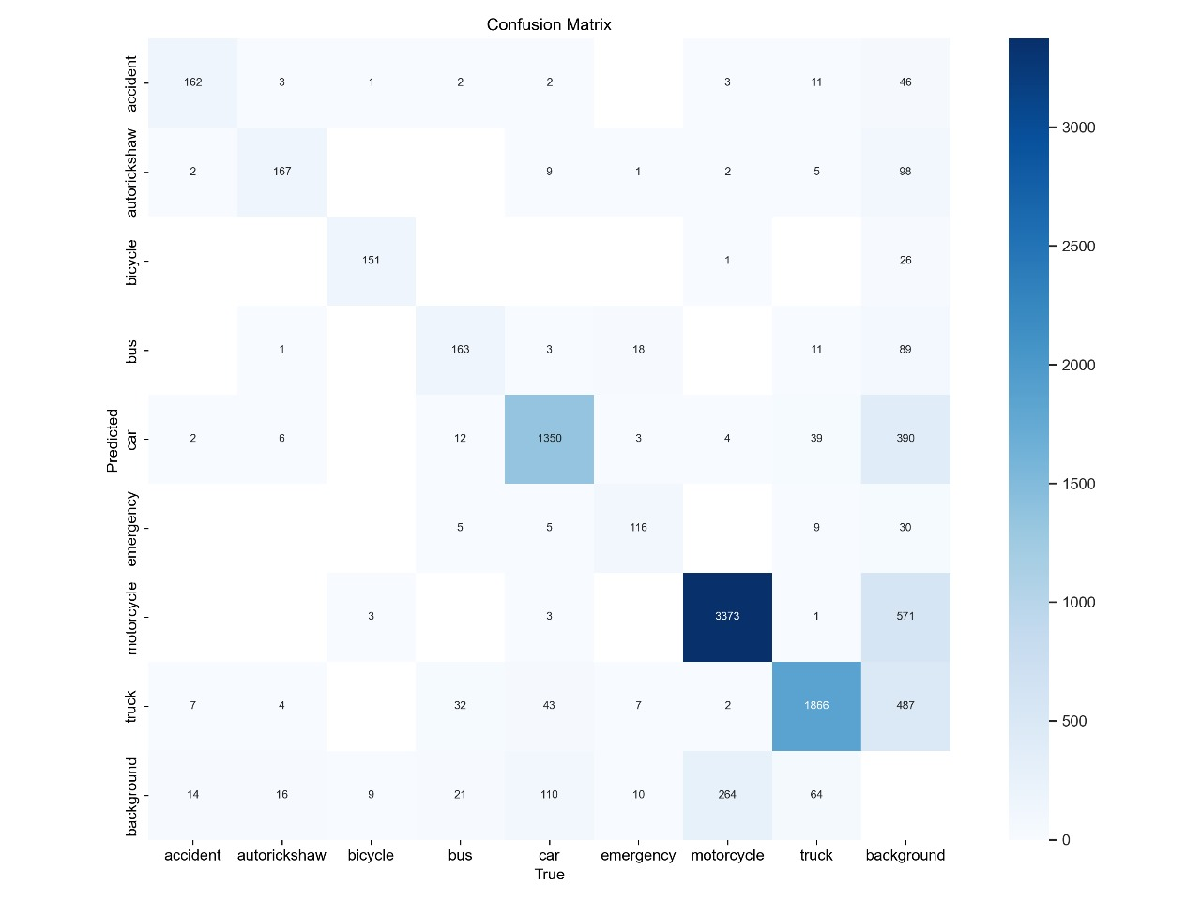
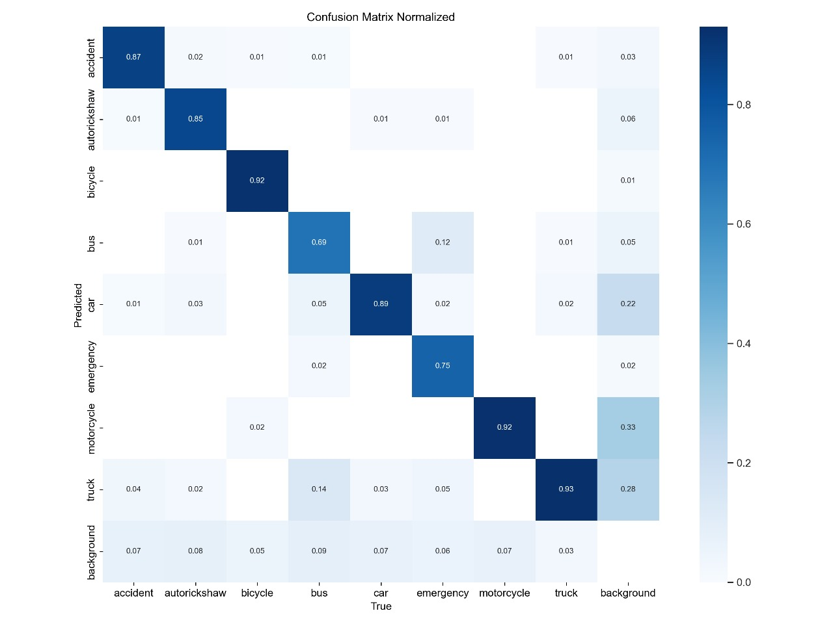
Confusion Matrix:

Slide 15
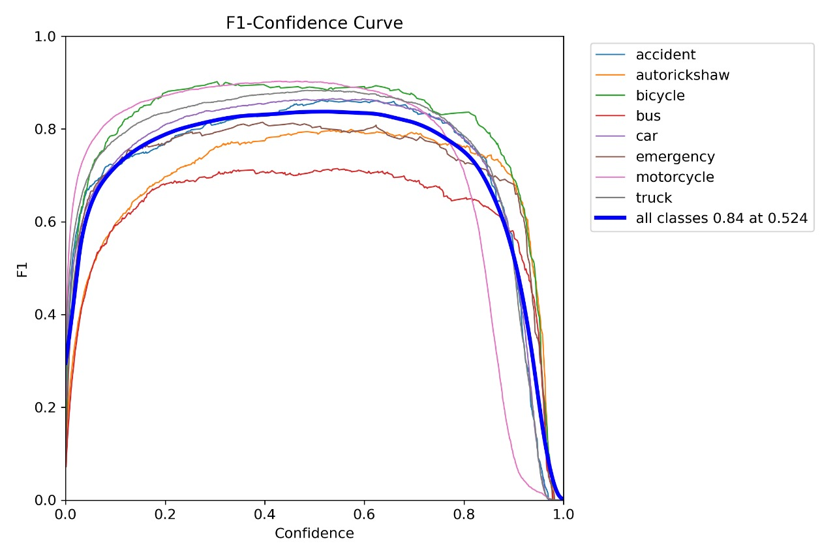
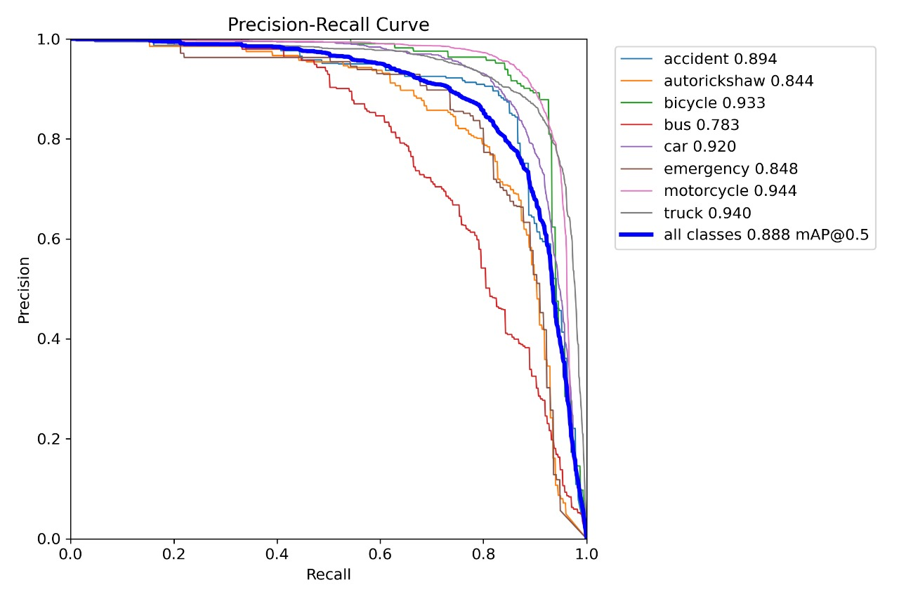
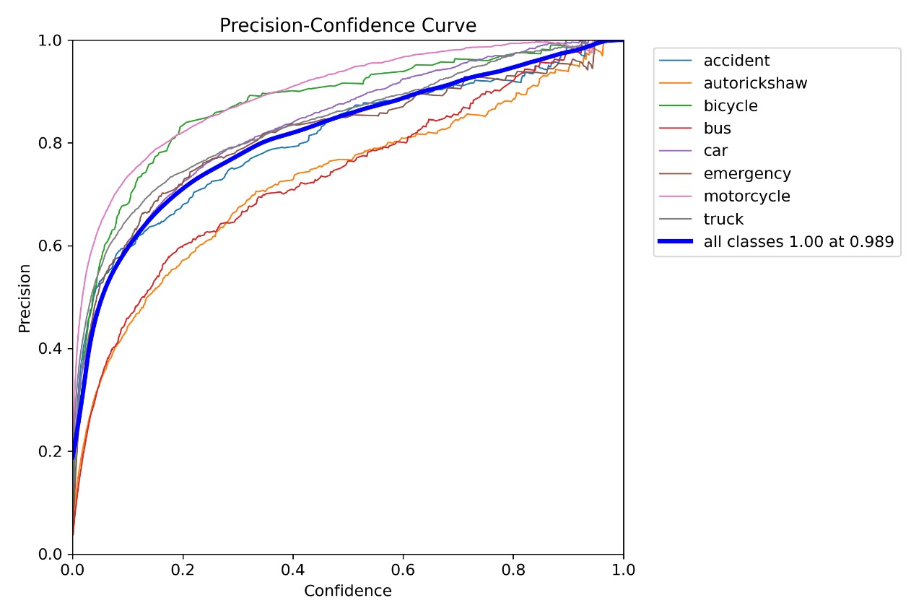
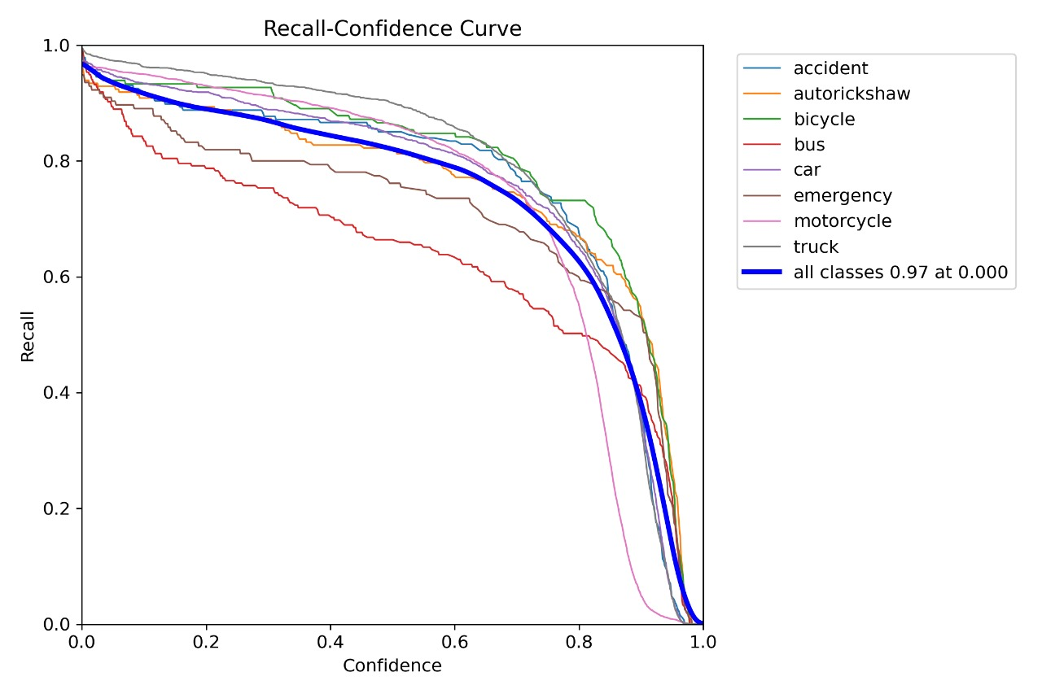
Precision Curves :

Slide 16
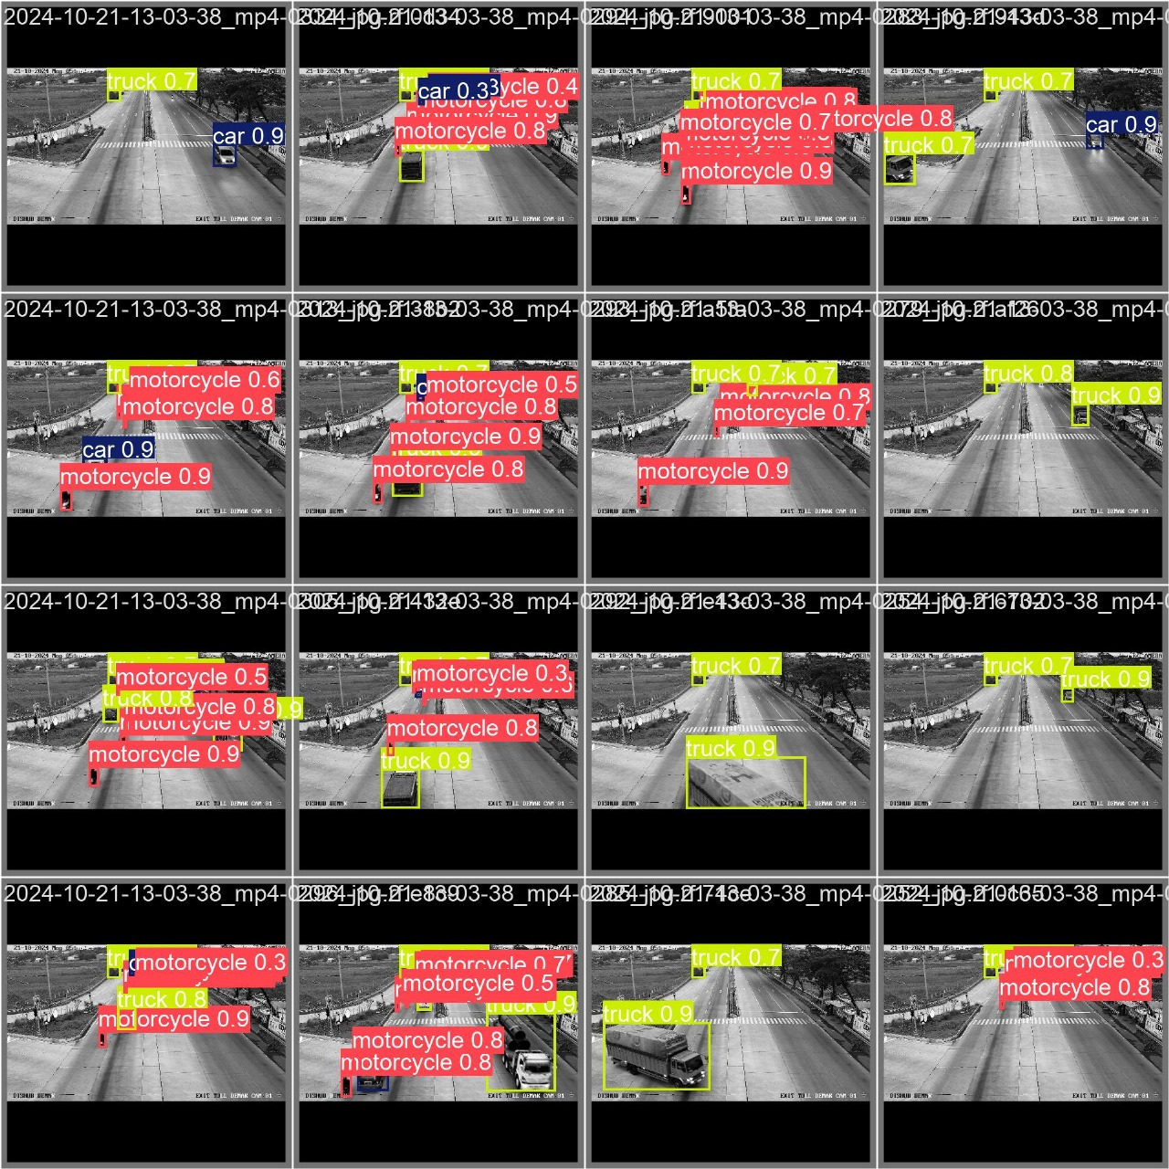
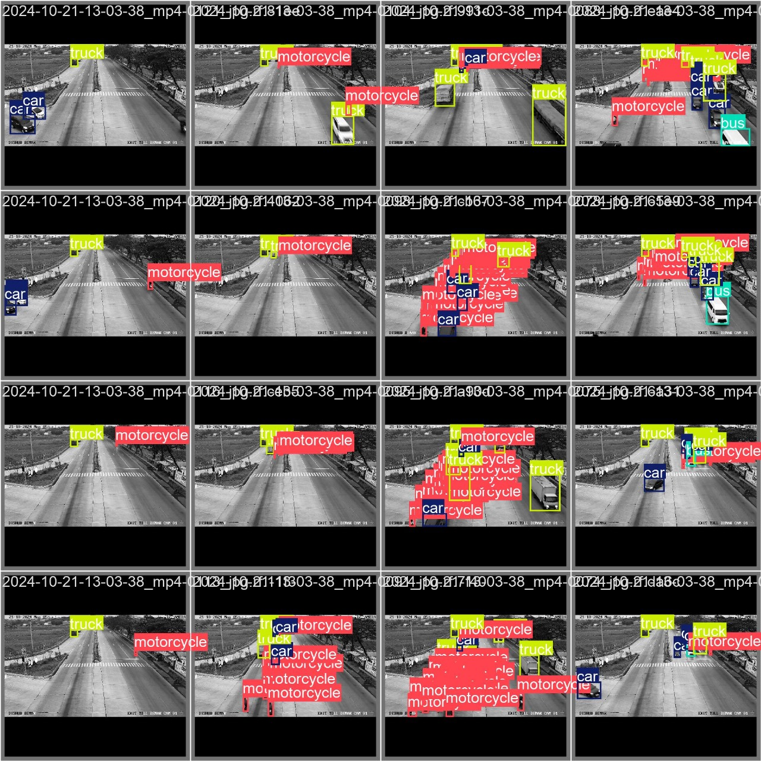
Annotation Results:

Slide 17
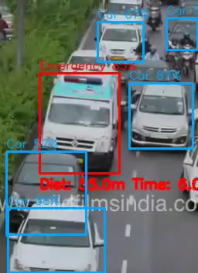
Result :

Slide 18
Formulae and Calculations
1. Distance Calculation
To estimate the distance of a detected vehicle from the camera, we use the pinhole camera model, where the distance is derived from the known real-world size of the object and its size in the image.
D = F x H(real)/H(img)
Where:
D = Distance of the vehicle from the camera (meters)
F = Focal length of the camera (pixels or meters)
Hₘₑₐₗ = Actual height of the vehicle in the real world (meters)
Hₘᵢₐgₑ = Height of the vehicle in the image (pixels)
-----------------------------------------------------------------------------------------------------------------------------------------------------
2. Adjusted Estimated Time to Cross
Now, using the adjusted speed in the time estimation formula:
T(adj) = D/V(adj)
Where:
Tₐ𝒹𝒿 = Adjusted estimated time to cross the point (seconds)
D = Current distance of the vehicle from the reference point (meters)
vₐ𝒹𝒿 = Adjusted speed from the previous formula (m/s)

Slide 19






TECHNOLOGIES USED
Backend Technologies: Python, Flask, Yolo, NumPy, Computer Vision
Frontend Technologies: Java Script, html, CSS, React, JSON

Slide 20
Conclusion & Future Work
Summary and Conclusion
Summary:
The YOLOv11n model was trained to detect emergency vehicles. Initially, it had 73% accuracy after 50 epochs. Improvements were made to detect bikes, cars, motorcycles, ambulances, and fire engines. Instance segmentation helped classify vehicles better. After multiple iterations and data augmentation, the final model achieved over 90% accuracy. The system also estimated the distance of emergency vehicles and adjusted traffic signals accordingly. It processed live video feeds efficiently for real-time traffic management.
Conclusion:
The model accurately detects emergency vehicles and adjusts traffic signals to give them priority. It classifies different vehicle types well. The system works in real-time and can help improve traffic flow and emergency response times. This system is adaptable to real-time conditions, making it a strong candidate for deployment in smart traffic management systems. It is suitable for smart traffic systems.

Slide 21
THANK YOU
Have a Great Day !

